Slide 1

JP Patent Law Amendment in 2014

Slide 2
Overview of New Amendment
Reintroduction of Post-Grant Opposition System
Expansion of Remedy for Lapse of Period for Procedures

Slide 3
A. New Opposition System (1)
1. History of Opposition System in JP
1959: Pre-Grant Opposition System Established
(Opposition Term: 2 M)
<1987: Opposition Term Extended to 3 M>
1994: <Former> Post-Grant Opposition System Introduced
(Opposition Term: 6 M)
2003: <Former> Post-Grant Opposition System Abolished
2014: New Post-Grant Opposition System Introduced

Slide 4
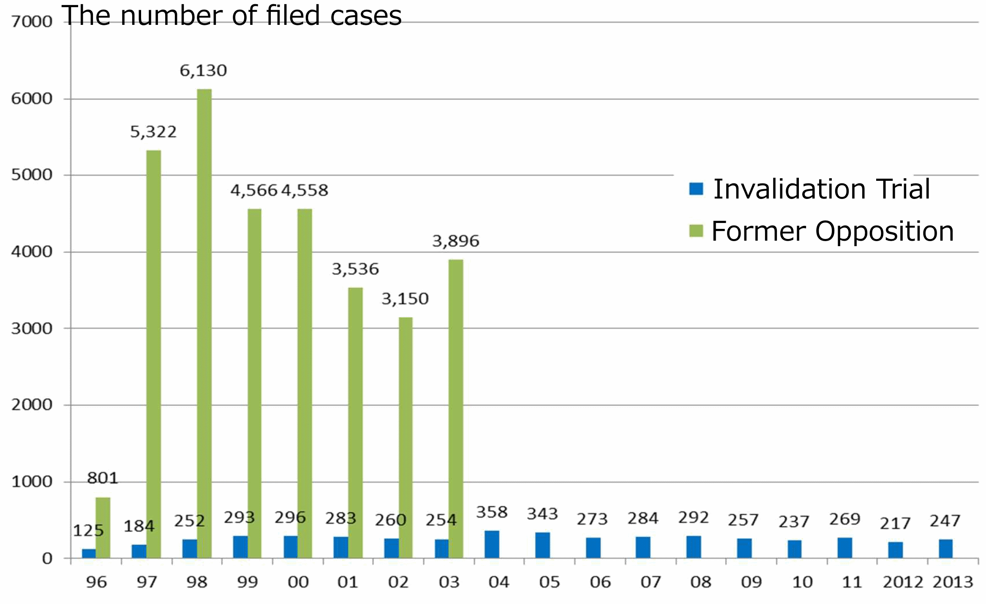
A. New Opposition System (2)
2. Backgrounds of Reintroduction of New System
After Abolishment of Former Opposition System, It was Expected that Number of Invalidation Trials increased, but actually not Increased.
→ Much More Defective Patents would survive, which was against
“Public Interest”.
To Address Concern, JPO Planned to Reintroduce New Opposition
System by making it easier to Use than Invalidation Trial.

Slide 5
A. New Opposition System (3)
3. Flowchart of Proceedings of New Opposition System
Issuance of Patent Grant Publication
6 Months
Patentee
Filing of Opposition
Opponent
Copy of Brief
Opposition Brief
*1
Notice of Reason(s) for Revocation
Board
Documentary Exam.
*3
Copy of Correction
Argument
Correction
*4
Argument
*2
Advance Notice of Decision
Repeating *1 to *4
Decision of Maintenance
Decision of Revocation
Appeal to IPHC

Slide 6
A. New Opposition System (4)
4. Who may File Opposition?
“Any person” may. = No Interest is Required.
“Straw Man” also may. (Anonymity: NG)
But, Patentee is NOT allowed.
∵ Against Intent of System for Public Interest
5. When may Opposition be Filed?
Only Within 6 Months from
Issuance Date of Patent Grant Publication.
≠ Allowance Date, Grant Date
No Extension is Allowed, even for Foreign Opponent.
If Opposition is Filed After Due Date, it is Dismissed.
Opponent may Withdraw Opposition Before Issuance of Notice of Reasons for Revocation.
6. How Much does it Cost for Filing Opposition?
\16,500 (ca. $140 ) + \2,400 (ca. $20) x No. of Opposed Claims as Official Fee. (Less than Half of O. F. for Invalidation Trial)

Slide 7
A. New Opposition System (5)
7. What Grounds may Opposition be Filed on?
Grounds for “Public Interest” Only. = Novelty, Inventive Step, Double Patenting, Enablement, Support, Claim Clarity, New Matter …
Grounds for Formal Matter: No
(Ex. Breach of Unity of Invention, Shift Amendment)
Grounds for Ownership of Right: No
(False Inventorship, Breach of Joint Application)
Grounds Occurred After Grant: No
(Ex. Patent no longer complies with treaty after grant,
Correction has been made contrary to the Law)
If Patent has plural Claims, Opposition may be Filed for Each Claim.

Slide 8
A. New Opposition System (6)
8. Examination Procedures (1)
Opposition Brief shall be written in Japanese. If Exhibit is in Foreign Language, Japanese Translation is Required.
Board of Appeal-Examiners (usually 3 persons) Examines Opposition.
Documentary Exam. Only. = No Oral Proceedings.
- But, Examination of Witness or Evidence may be Made.
When Plural Oppositions are Filed, Board generally consolidates them.

Slide 9
A. New Opposition System (7)
8. Examination Procedures (2)
First, Board substantially Examines the Case, and then,
(i) if Board Finds NO Reasons for Revocation,
Board directly issues Decision of Maintenance of Patent
without providing Opponent with opportunity of
additional explanation or supplemental argument.
(ii) if Board Finds any reason for Revocation,
Board Issues Notice of Reasons for Revocation to Patentee.
In response to Notice, Patentee may File Argument and Request for Correction within 60 days (for Domestic Patentee) or 90 days (for foreign Patentee).
It costs “\49,500 (ca. $410) + \5,500 (ca. $45) x No. of Granted Claims” as Official Fee for Request for Correction.
If Correction is Requested, Opponent may File counterargument within 30 days (for Domestic Opponent) or 50 days (for foreign Opponent).

Slide 10
A. New Opposition System (8)
8. Examination Procedures (3)
Interview with Board:
- Patentee may have interview with Board at least once
during examination at Patentee’s Request.
- Opponent is NOT allowed to Join the Interview, or
to have interview with Board.
- Exceptionally, Board may request Opponent to make any
technical explanation in interview.
Taking into consideration response(s) from Patentee (and Opponent), Board further examines the case, and then,
(i) If Board Finds No Reasons for Revocation anymore,
Board issues Decision of Maintenance.
(ii) If Board Still Finds any Reason for Revocation, Board
issues 2nd Notice of Reason for Revocation (Advance Notice
of Decision), which has very similar form to Final Decision.

Slide 11
A. New Opposition System (9)
8. Examination Procedures (4)
In response to 2nd Notice, Patentee may further file Argument and Request for Correction, against which Opponent also may file counterargument.
Taking them into consideration, Board further examines the case, and issues Final Decision of Maintenance or that of Revocation.
When Decision of Maintenance has become Final and Binding,
Patent is Maintained.
When Decision of Revocation has become Final and Binding,
Patent shall be deemed to be Retroactively Revoked.
It is expected that it Takes about 1 year or less from filing Opposition to Issuance of Final Decision by Board.

Slide 12
A. New Opposition System (10)
8. Examination Procedures (5)
Appeal Against Board’s Final Decision
- Decision of Maintenance: Opponent CANNOT File Appeal.
- But, Prohibition of Double Jeopardy is NOT applied,
and thus Opponent may File Invalidation Trial
even based on Same Facts and Same Evidences as Opposition.
- Decision of Revocation: Patentee may File Appeal
before IPHC within 30 days (for Domestic Patentee) or
120 days (for foreign Patentee).
- Defendant: NOT Opponent, but Commissioner of the JPO

Slide 13
A. New Opposition System (11)
9. New Opposition v. Former Opposition
 | New | Former
Standing | Any Person (excluding Patentee) | Same
Term | Only 6 Months after Issuance date of Patent Grant Publication | Same
Grounds | On Public Interest Only | Same
Subject of Exam. | Board of Trial Examiners | Same
Method of Exam. | Documentary Examination Only | Optionally Oral Proceedings
Appeal | Patentee: IPHC Opponent: No means | Same
Argument against Correction | Opportunity legally-Guaranteed | No Opportunity Guaranteed (Interrogation could be Issued)

Slide 14
A. New Opposition System (12)
10. Opposition v. Invalidation Trial
 | Opposition | Invalidation Trial
Standing | Any Person (excluding Patentee) | Interested Party Only (Amended from Any Person)
Term | Only 6 Months after Issuance date of Patent Grant Publication | Any Time after Grant, Even after Patent Expiration
Grounds | On Public Interest Only (Novelty, Inventive step, Description Deficiency, New Matter, … ) | On Public Interest On Ownership of Right Occurred After Grant
Subject of Exam. | Board of Trial Examiners | Board of Trial Examiners
Method of Exam. | Documentary Examination Only | Oral Proceedings
Appeal | Patentee: IPHC Opponent: No means (No Prohibition of Double Jeopardy) | Patentee: IPHC Demandant: IPHC

Slide 15
A. New Opposition System (13)
11. Opposition in JP v. Post-Grant Review & Ex Parte Reexam. in US
 | Opposition in JP | Post-Grant Review in US | Ex Parte Reexam. In US
Standing | Any Person (excluding Patentee) | Interested Party | Any Person (including Patentee)
Term | 6 Months after Issuance date of Patent Grant Publication | 9 Months after Patent Grant | Any Time After Grant
Grounds | On Public Interest | Any Grounds for Invalidity | Novelty, Obviousness Only
Subject of Exam. | Board of Trial Examiners | Patent Trial and Appeal Board | Examiner
Method of Exam. | Documentary Exam. Only | Oral Proceedings | Documentary Exam. (Optionally Oral Proceedings)
Appeal | Patentee: IPHC Opponent: No means | Patentee: CAFC Petitioner: CAFC | Patentee: Board Others: No means

Slide 16
A. New Opposition System (14)
12. Tips for New Opposition System (1)
To Opponent:
New System is more Convenient and Inexpensive.
Consider Actively Utilizing System.
Opposition Term is Still rather Short.
If You have Concerned Pending Patent Application,
Watch Status and Search and Collect Related Prior Art
References in Advance in case of Filing Opposition.
Even under New System, when Patentee does NOT Request Correction, Opportunity of Counterargument against Patentee’s Argument is not legally guaranteed.
Inspect File Wrapper After Patentee’s Response, and
Consider Voluntarily Filing Counterargument ASAP.

Slide 17
A. New Opposition System (15)
12. Tips for New Opposition System (2)
To Patentee:
Response to Advance Notice of Decision would be Last Opportunity to Make Correction, and No Correction is Allowed After Decision of Opposition at all, even in Appeal Stage.
Very Carefully Consider Correction at that Stage.
Interview is Favorable Procedure to Patentee since Opponent cannot Attend it, and No Auxiliary Request is Allowed.
Actively Utilizing Interview, in particular, when Considering
Correction.

Slide 18
B. Expansion of Remedy for Lapse of
Period for Procedures (1)
1. Relief for Lapse of Filing Request for Exam.
Former Law
New Law
Patent Filing
Request for Exam.
3 yrs.
If there is “Due Cause” for Lapse,
Max. 1 yr.
What is “Due Cause”?
e.g. Natural Disaster, Management Software bug,
Sudden Serious Illness, but Human Error

Slide 19
B. Expansion of Remedy for Lapse of
Period for Procedures (2)
2. Relief for Lapse of filing a patent application claiming a priority within the priority period
Former Law
New Law
Patent Filing in US
Patent Filing in JP
Claiming
Priority
1 yr.
If there is “Due Cause” for Lapse,
2 M
What is “Due Cause”?
e.g. Natural Disaster, Management Software bug,
Sudden Serious Illness, but Human Error

Slide 20
C. Effective Date
It has already become effective from April 1, 2015.
Opposition may be Filed on Patents of which Patent Grant Publication is Issued on or after
April 1, 2015.

